Slide 1
Technology-enhanced assessment

Slide 2
Overview
  Introductions and context
  Assessment and feedback challenges
  Tools to support approaches to change
    Assessment for learning practices
    Effective electronic management of assessment (EMA)
  Examples and resources
Notes:
This session aims to share some of the top level messages arising from a large body of work around assessment and feedback for those considering the issues at a strategic level.
I’ll start with sharing some of the findings of a number of UK wide reviews into assessment and feedback which unearth some of the sector-wide challenges being faced
And then discuss some tools and approaches to tackling these challenges, supported by technology, that have proven beneficial.
There are two themes running throughout this presentation – assessment and feedback practices in terms of pedagogies and purposes of assessment, and the management of assessment and feedback processes which follow to support the achievement of those pedagogies.

Slide 3

Background and context
  2011-2014: A 3 year programme exploring
  technology-enhanced assessment and
  feedback
  2012: Baseline reviews of the institutional
  landscape
  2013: Case studies, videos and briefings
2014: EMA landscape review
2015: New Transforming Assessment and
Feedback Guide
Notes:
This body of work, funded by Jisc started back in 2011 aiming to explore large scale changes to assessment and feedback, supported by technology.
It involved 20 projects, and over 30 institutions across the UK from Cornwall to Dundee to Belfast, involving over 2,200 staff and 6000 students.
As part of this work, in 2012 8 of the institutional change projects (7 HE and 1 FE college) reviewed their institutional landscapes with regards to assessment and feedback as a starting point from which to measure their enhancements.
Out of this body of work came a range of advice and guidance outputs, including video and written case studies, and briefings on the four main themes:
Electronic management of assessment
Feedback and feedforward
Employability
Approaches to change
One of the themes arising from this work was the electronic management of assessment, (EMA for short), which encompassed online submission, marking and feedback, and the many other stages involved in the end to assessment and feedback lifecycle. From evaluations of EMA the potential benefits of the approach were clear – see the guide on EMA. From this, we undertook a UK-wide review of the EMA landscape, exploring the state of play, challenges and painpoints.
The EMA project has since worked with a number of institutions to identify potential solutions to the challenges identified which I’ll touch on today.

Slide 4

Assessment and feedback challenges
highly devolved responsibility & inconsistent practices
lack of developmental focus
traditional practices dominate
timeliness, quality and consistency of feedback
learner in passive role
lack of relevance to world of work
CC BY-NC-ND 2.0 Whirling Phoenix
Notes:
Wanted a point in the sand from which to measure progress from. So all 8 institutional change projects provided a baseline review of what was happening on the ground.
The research showed pockets of good practice, but overall a consistent picture of the challenges and highlighted the problems that exist with resistance to change, and the scaling up of good practice and innovation.
In terms of strategy and policy, a key issue is that although there maybe an overall assessment strategy, responsibility for implementing it is devolved to departments/faculties. This results in considerable variation in assessment and feedback practices, making it difficult to achieve parity of experience for learners.
Another key issue is that strategy documents tend to be quite procedural in focus and don’t reflect current thinking around effective assessment practice and the value that assessment can bring to learning.
When it comes to academic practice the issues are varied and complex but include the emphasis on summative assessment and the persistence of traditional forms such as essays/exams.
Timeliness, along with quality and consistency of feedback, was an issue across the board. Even where clear deadlines are set there isn’t always in time to feed into next assignment. Curriculum design (modular approach) can also provide barriers to the ongoing developmental approach to feedback at a programme level.
There is a perception that learners don’t engage with the feedback they receive. Tutors may feel they have given a lot of feedback and support but it hasn’t been acted upon. Learners are seen as passive – waiting for feedback to be delivered to them but the reality is less clear cut as the value of acting on feedback is not always well-communicated, and was notably absent in most induction processes. Learning design often puts the learner in a passive role.
And finally, the assessment and feedback process, particularly the emphasis on high-stakes assessment and the value that is placed on marks and grades, is very different to the formative ways professionals develop during their working life, where much value is gained from feedback from for examples peers.

Slide 5
Electronic management of assessment
Challenges exposed
  Localised initiatives but beginning to
  scale up - e-submission, e-marking, e-feedback
  System integration is a key problem area
  EMA exposes variability in business processes
“The use of technology is now a fundamental part of the support for assessment and feedback practice across the sector, but there are few examples of fully integrated approaches to supporting the whole assessment and feedback lifecycle”
Jisc, 2014
Notes:
In 2012 we researched the state of play with regards to where colleges and universities were with regards to the electronic management of assessment, so for example with online submission, marking and feedback of assignments. Overall from the EMA research, although there were nuances to the findings, broad trends were visible.
There was a recognition that there were a number of localised initiatives in this area that were starting to scale up, and it was clear that institutions are increasingly moving beyond experimentation and are looking to take a more strategic approach to the application of EMA – 2011 HelF survey reported 21% of members felt confident they had policies and procedures in place to 55% of respondents in 2014 saying their LT&A assessment strategy made explicit ref to EMA. Although that may not be instit wide. There are some egs of policies in development in the report.
The challenges were evident across all three areas of technology, process and practice – it won’t come as a surprise that integration of systems was a key problem area, as was the variation in business processes unearthed when technology solutions were put into play, as well as challenges with assessment and feedback practice which I’ve already touched on.

Slide 6
Electronic management of assessment
Loose system integration
Variation in business processes
  Limited range of core technologies
  Integration loose and requiring manual intervention
  More HEIs say their A&F systems are ‘completely separate’ than ‘highly integrated’
  Lots of local variation
  Only 12% of HEIs have ‘highly standardised’ processes
  Different interpretations of policy
  Variation hidden till EMA tried
‘The challenge of disjointed systems makes it challenging to monitor student progress and identify at risk students. Similarly, there is no opportunity for the students to monitor their own progress prior to final assessments.’
Jisc (2014) EMA Landscape Review
Notes:
Loose system integration
Despite the diversity of UK academic practice, there is a limited range of core technologies supporting EMA on an institution wide basis. The key systems are generally: SRS, VLE, dedicated assessment platforms: with the submission, originality checking, feedback and marking functionality in the Turnitin product suite being widely used.
Looking at the combination of these systems, two main options predominate: and between them SITS/Blackboard Turnitin and SITS/Moodle/Turnitin account for almost half of institutions (the SITS/Blackboard Turnitin combination accounting for around 25% of HEIs being the most common.
Despite the relatively limited nature of the core product set, the key integration points between these technologies remain problematic and a source of considerable manual intervention.
Business processes
Institutions reported much variation in business processes– which reflects the findings from the assessment and feedback programme – which highlighted the extent of the diversity with regard to how a&f strategy is translated into more localised policy. reflects 2 sides of same coin – harder to integrate systems (& design effective workflows) when business processes are very varied.
The 12% that said their processes were highly standardised, tended on the whole to be quite small/specialist. Or had undertaken a lot of business process review already.
The devil is in the detail – the free text comments give a lot more insight on this, including the challenges being faced, including time for staff to step back and look at why things are happening, and at times misunderstandings of policies.

Slide 7
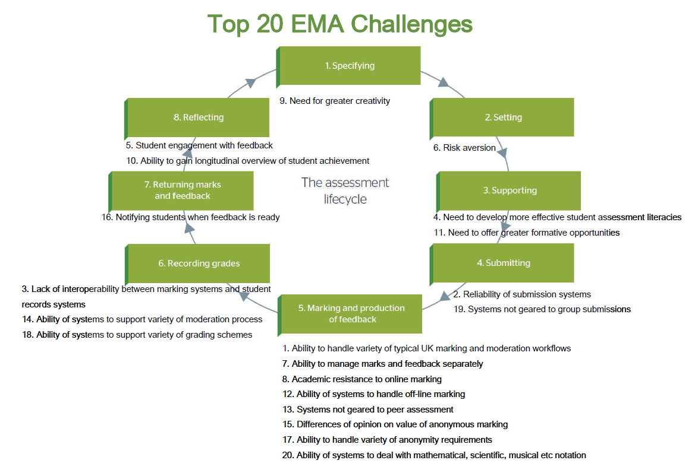
Top 20 EMA challenges
Notes:
Having unearthed a host of issues we did some work with the community looking at what are the real priorities to address – which of these issues have the biggest impact on most stakeholders.
These are the top 20 issues as mapped against the A&F lifecycle.
Ability of the technology to handle a variety of typical UK marking and moderation workflows
Reliability of submission systems
Lack of interoperability between marking systems and student record systems
Need to develop more effective student assessment literacies
Student engagement with feedback
Risk aversion
Ability to manage marks and feedback separately
Academic resistance to online marking
Need for greater creativity
Ability to gain longitudinal overview of student achievement
But what’s most interesting is when you map these 20 onto the a&f lifecyle:
At the start of the research there was a general feeling that stages 2-4 are better understood and less problematic than some of the other components of the life-cycle, not least because many institutions are managing all of the related information within a single VLE system. Stages 5-8 were felt to be where we begin to open Pandora's box ... This proved to be borne out by the findings of the research.
You can see the clustering around the later stages of the lifecycle, particularly around marking and production of feedback and recording grades. There are also a lot of issues that together group around the theme of student assessment literacies.
Marking and production of feedback appears to be the most problematic component of the life-cycle as it is the area where variety of pedagogic practice results in a situation where the fit between institutional processes and the functionality of commercially available systems is least well matched. We heard a very clear message from universities that existing systems do not adequately meet UK requirements in these areas. A basic issue is that marks and feedback are different things and need to be handled differently whereas technology platforms tend to conflate the two. It was also observed that systems seem too often to be predicated on an assumption that 1 student = 1 assignment = 1 mark. This model may usually be adequate for formative assessment but does not meet UK requirements for summative assessment processes. Systems would ideally offer a range of different workflows based on different roles e.g. first marker, second marker, moderator, external examiner etc.

Slide 8
Moving from challenge to change
Useful tools and approaches
Principle-led approaches to change
  Moving to an ‘assessment for learning’ approach
The assessment and feedback lifecycle
  Supporting the electronic management of assessment

Slide 9
Rethinking assessment practices
Evidence that assessment, rather than teaching, has a major influence on students’ learning
Increasing consensus of the importance of developing judgement and self-regulation in learners as critical skills for life and employment
But existing assessment practices often focus on the demonstration of knowledge and memory recall rather than the processes of learning
So…… are we best preparing learners for a lifetime of learning and employment?
Notes:
There is substantial evidence to suggest that assessment, rather than teaching has a major influence on students learning.
There is also growing consensus in the literature of the importance of development learners self regulatory abilities, and their ability to judge their performance as a k key skill for life and employment.
But, when we look at our assessment practices, we can see a picture that is misaligned, with very much a focus on the assessment of knowledge and, in exams, memory recall. Knowledge will always be an important component of education, but are we best preparing learners for a lifetime of learning and employment where learners now are entering a very different world than we as graduates would have? This question goes deep into defining what our educational experiences should be looking to achieve.
How often to we really stop and think about the purpose of assessment and feedback? The literature and research into effective assessment and feedback practice is clear on the importance of assessment for learning approaches, but are our practices aligning?
So the focus here is on approaches that move us away from summative, assessment of learning approaches to more formative assessment for learning approaches, thinking through how the technology can be an enabler.

Slide 10

A starting point for change: a principled approach
Importance of defining the purpose of assessment and feedback
Need to articulate that underpinning vision before embarking on change
Principles are a good way to articulate and operationalise this
  Provide a synthesis of the research
  Action oriented
  Evaluation device
CC BY 2.0 Mind_scratch
Resources
Why principles? http://www.reap.ac.uk/TheoryPractice/Principles.aspx
Overview of principles: http://jiscdesignstudio.pbworks.com/w/page/40343419/Assessment-and-feedback-principles
Notes:
An approach to supporting institutions to reopen these questions is that of starting with educational principles as a way of helping institutions to have conversations and agree a pedagogical basis for change, and to support the decisions around how tech can support these newly designed assessment practices.
The use of principles for assessment and feedback has gained traction across the sector and provides an educational scaffold on which to drive change aligned to educational principles, and synthesise from the literature what ‘good’ assessment and feedback’ looks like.
There are a few different sets which can be good starting points for discussion – see the URL here for a summary of all sets. Egs Gibbs and Simpson (2004), NUS Nicol and Macfarlane (2006) and NUS (2008), Univ Herts ESCAPE project (2010).
PRINCIPLES:
Provide a synthesis of the research and so can act as a translation device
Can be written in a way that specify an action (but do not detail that) and so can operationalise a vision into practical steps.
Can also act as an evaluation tool, so for example how does the technology support the implementation of the principles?
SEE a full list of principles (Mark Russell) and also Prof David Nicols work with more on the principles approach.

Slide 11
REAP principles
Good assessment and feedback should: support the development of learner self-regulation
  Clarify what good performance is (goals, criteria, standards)
  Facilitate the development of reflection and self-assessment in learning
  Deliver high quality feedback to students: that enables them to self-correct
  Encourage peer and student-teacher dialogue around learning
  Encourage positive motivational beliefs & self esteem through assessment
  Provide opportunities to act on feedback
  Provide information to teachers that can be used to help shape their teaching (making learning visible)
  Nicol and Macfarlane-Dick (2006)
Notes:
For example, these are the REAP principles from the University of Strathclyde. They emerged from an overall vision that assessment and feedback should firstly and foremost support the development of learner self-regulation (now strongly borne out from the research literature).
These 7 principles were used to drive student feedback campaigns, were written into institutional strategy, and have been used to inspire many others to take on this approach. They started at 7 (Nicol and McFarlane-Dick (2006) but grew to 12 (Nicol 2009).

Slide 12
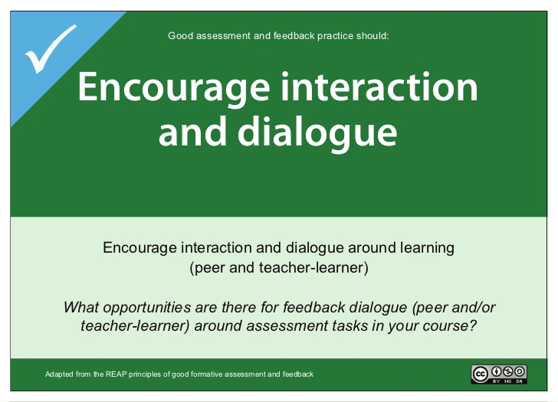
Putting principles into practice – Viewpoints
Notes:
Projects have explored a range of approaches based on principle led change, and have developed a range of tools to support the approach.
For example, the Viewpoints project at the University of Ulster has developed a workshop activity with course teams that enables them to discuss and agree what good assessment looks like (using cards with each principle on, and examples of principle based cards), and at which point in the students journey that should be implemented, and how technology can enhance it.

Slide 13
Putting principles into practice – Viewpoints
Notes:
EG. A principle around assessment and feedback should: Encourage interaction and dialogue - activities include…reviewing feedback in tutorials, and ‘encourage learners to give each other feedback on an assessment in relation to the criteria before submission’
Principles now embedded in quality procedures and policy.

Slide 14
Putting principles into practice, QUB
Notes:
Queens University have used the principles to articulate the assessment redesigns – firstly they outlined their underpinning principle that all A&F should ‘ encourage positive motivational beliefs and self-esteem’, and the other key principles under that. They colour coded them…

Slide 15
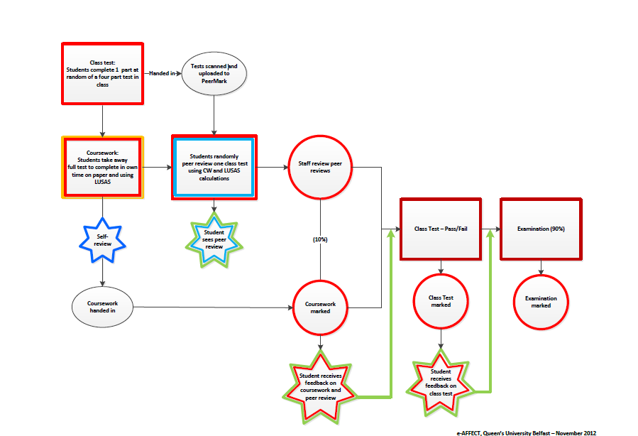
Putting principles into practice, QUB
Notes:
Which enabled maps of the assessments designs before and after to be colour coded to show how each part of the assessment process is supporting each underpinning principles.
This example illustrates an engineering module assessment redesign, the box in the middle which describes students peer reviewing another students test, has been colour coded for ‘helping to clarify good performance’, and ‘deliver high quality feedback’.
What has emerged is that principles provide a discourse for change and this can be a powerful lever to ensure that processes and practices supporting assessment and feedback all benefit learning.

Slide 16
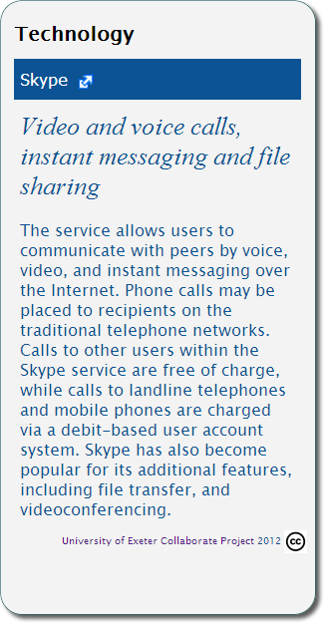
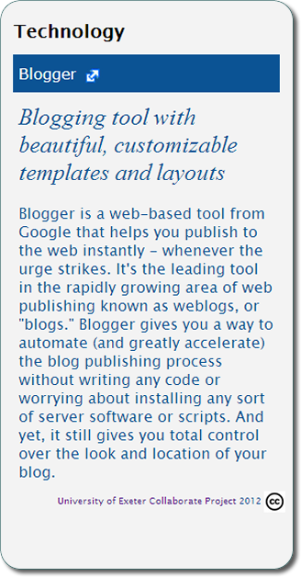
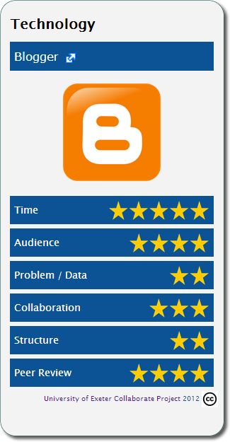
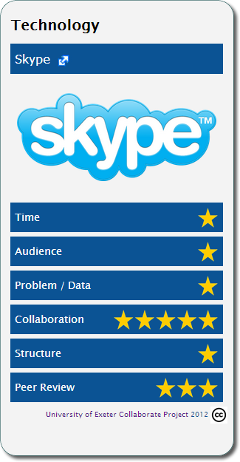
Aligning technology with principles
University of Exeter ‘Tech Trump’ cards
Notes:
Finally we get round to mentioning technology and there are some lovely examples of resources projects have used to help make people make technology choices based on the type of learning and teaching approach they are trying to implement.
For example here each technology is ranked according to how it supports each of the dimensions of the work-integrated model, so for example skype rates here high on supporting collaborative activities, less so for others.
These tech trump cards are one example from the University of Exeter, others have done similar things.

Slide 17
Examples in practice
Supporting longitudinal development
The role of feedback
More formative opportunities
Feed forward
Ipsative approaches
Access to feedback
Assessment scheduling
Feedback is a ‘black box’
Programme teams don’t discuss feedback
Useful analytical tools available
Notes:
Supporting longitudinal development
So one of the key elements of a move towards assessment for learning approaches is a focus on seeing the learning journey in its entirety, and supporting a more holistic view of student development over time. This involves providing more formative opportunities to influence development, incorporating ipsative approaches whereby feedback acknowledges progress against the learner's previous performance regardless of achievement; and feedforward that focuses on proving advice focused on how to improve moving forward.
Although this is primarily a learning design issue, technology has a vital role to play here in terms of storing feedback across a programme and making it easily accessible to both staff and students in order to develop a long-term picture – but it was found that most of the VLEs in common use record both marks and feedback at a module level so that it is not easy to gain this kind of overview at programme level. This is one of the areas we’ve had a focus in on the project – and there is a growth in interest at the moment from systems providers in enabling this sort of view for both staff and students.
Institutions explored a variety of ways that technology could resolve some of these issues, from
Using simple tools to analyse the timing of assessments, feedback dates and ensuring students could act on fb before producing the next piece of work
Developing tools to analysis and audit feedback
Creating conditions for staff/student dialogue rather than fb just being ‘delivered’ to students
Role of feedback
One of the most astonishing things the programme revealed was the lack of discussion that seems to take place around approaches to feedback.
The IOE, in looking to implement a more longitudinal approach, described feedback as taking place in a 'black box' and their experience seems to be borne out elsewhere.
The focus of quality assurance activities seems to be exclusively on comparing and moderating marks and it appears that there is little, if any, discussion within programme teams about individual approaches to feedback. It is therefore unsurprising that students talk about inconsistency in the feedback they receive, and the lack of any conversations amongst staff to establish and discussing the purpose of feedback seems to inhibit any longer term aims to better learner longitudinal devt.
Some of the really valuable resources from this programme are a range of audits (on paper and one online), in different institutions and using different methods, of the types of feedback given. These approaches were mainly set out to be evaluative, but have developed into staff development tools to engage staff in conversations around their feedback.
A number of the projects have produced tools for profiling and analysing feedback and many of these are readily available for others to use.

Slide 18
Case studies
Students as partners
Enhancing employability skills
Embedding EMA
Using technology to promote feedback dialogue
Viewpoints as a catalyst for change
Video case study: Reconceptualising feedback
bit.ly/jisc-assess

Slide 19
Moving from challenge to change
Useful tools and approaches
Principle-led approaches to change
  Moving to an ‘assessment for learning’ approach
The assessment and feedback lifecycle
  Supporting the electronic management of assessment

Slide 20

Why is EMA important?
“Amongst students there is very strong evidence to suggest that not only is electronic assessment management their preference, but that those who come to appreciate its attendant benefits then begin to see electronic assessment as their entitlement.”
EBEAM final report
  Increased control and agency
  Reduced anxiety
  Improved privacy and security
  Increased efficiency and convenience
  Feedback which is clearer and easier to engage with, understand and store for later use
Notes:
So we’ve talked a lot about assessment and feedback practice – I now want to touch more on the processes around electronically managing the assessment and feedback process. Why are we interested in this aspect? Based on the findings from a 5 year evaluation at the University of Huddersfield, we know its key (see briefing for more info):
One key finding is that students feel more confident with the process. It’s faster, more efficient, convenient and flexible. But when it comes to receiving feedback, students see it as inconsistent when submission is electronic and marks and feedback are on paper. It seems illogical to them that that inconsistency exists.
Benefits to students
increased control and agency – and reduced anxiety
For some, reduced anxiety due to increased control, over when, and where they engaged with their feedback. Clarity of date of return of feedback and results.
improved privacy and security – students were overwhelmingly confident in the process – so confident it hadn’t got lost, and that it had been securely submitted to the tutor and not visible to others. Liked the receipting – fast and automated. As compared to dropping it in a box in a pile with others. Or feedback wasn’t given in a class setting when others ask what you got. Provided a sense of connection with the tutor, particularly for distance learners.
sig increased efficiency and convenience – all students reported added convenience. Inc reduction in time submitting work, ‘hassle’ eg fighting with printers just before the deadline, and flexibility in submitting it to fit round their lives. Liked a midnight submission as they could work up to it.
feedback which is clearer and easier to engage with, understand and store for later use – More legible feedback - liked the way feedback worked in Grademark – inc bubble comments. Lack of engagement due to illegibility of the feedback? One student noted that having it online made it much easier to go back when doing another assignment and incorporate the feedback in as they went.
However, the research showed that there is a balance to be gained between giving staff flexibilty to come on board with e-marking when they are ready (which is key), and the strong entitlement students feel to it.
Recommended a system that is robust and secure, and allows for esubmission, but allows staff to mark in the way they prefer is likely to be the one that generates most benefits and least angst for the highest proportion of stakeholders.
It is likely a critical mass will be gained over time which should tip the balance with any reluctant staff.
Don’t recommend mandatory training for students, but should make available some self-paced online resources to support those that need it.

Slide 21
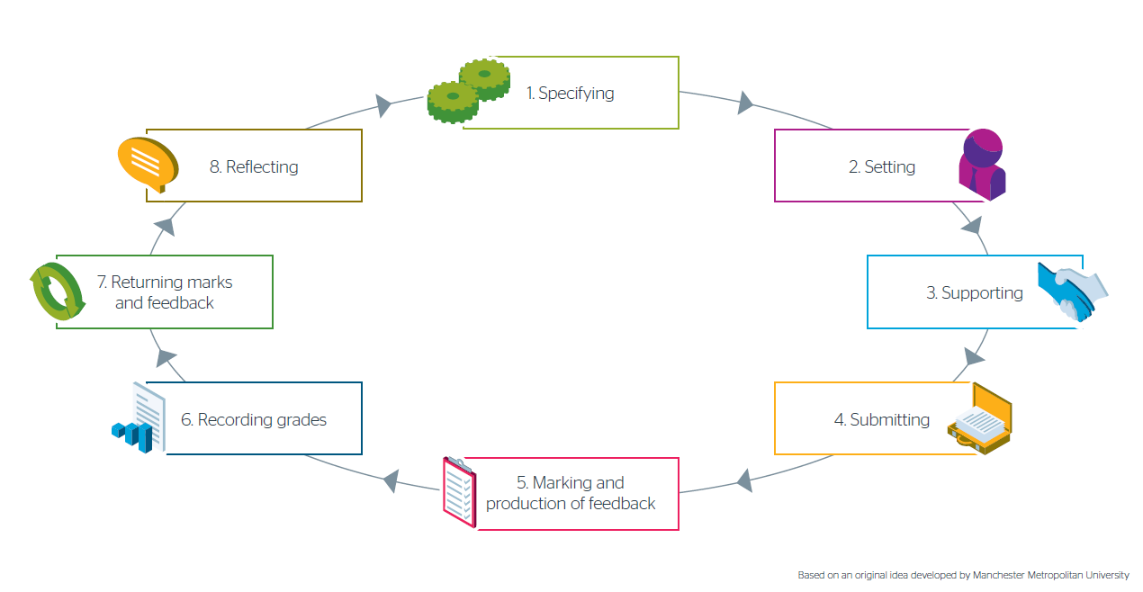
The assessment and feedback lifecycle
Notes:
In trying to review assessment and feedback practice overall it is easy to feel initially overwhelmed by the diversity of the landscape. Every institution develops its own policies, procedures and practices - usually the responsibility for this is highly devolved so there can be very different policies and practices between different departments or schools even within a single University. In trying to make sense of the overall picture, a tool that has proven very useful in providing a common starting point is the assessment and feedback life-cycle shown here.
The assessment and feedback life-cycle was originally developed by Manchester Metropolitan University and it has been picked up and used or adapted by many other institutions.
The life-cycle is an academic model. It shows a high level view of the academic processes involved in assessment and feedback and offers a ready means of mapping business processes and potential supporting technologies against this. The model can be applied to both formative and summative assessment and to any scale of learning e.g. from whole courses/programmes of learning or to short pieces of learning such as a short course that takes place over a single day. The model covers all assessment and feedback practice whether or not materials are in digital format and supported by information systems.
Use of this model has been central to our work in terms of serving as a common framework to gain an overall picture of institution wide activity. It offers a means of encouraging dialogue between different types of stakeholders who may work on one aspect of assessment and thus have a view of only part of the life-cycle. So far the model has resonated with everyone we have spoken to in the course of the research.

Slide 22
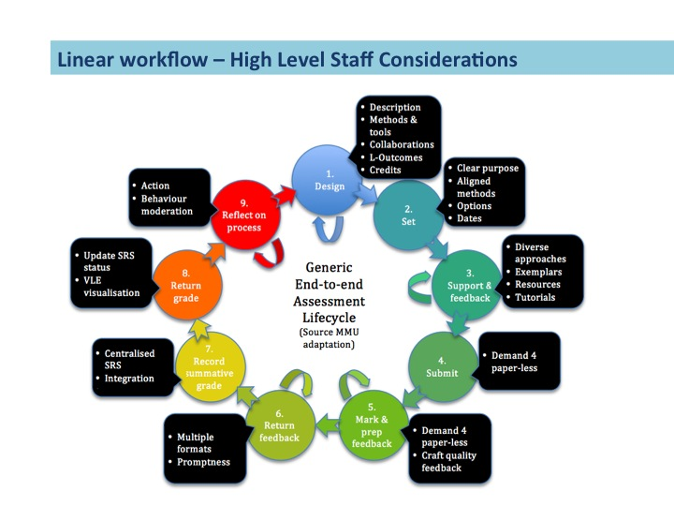
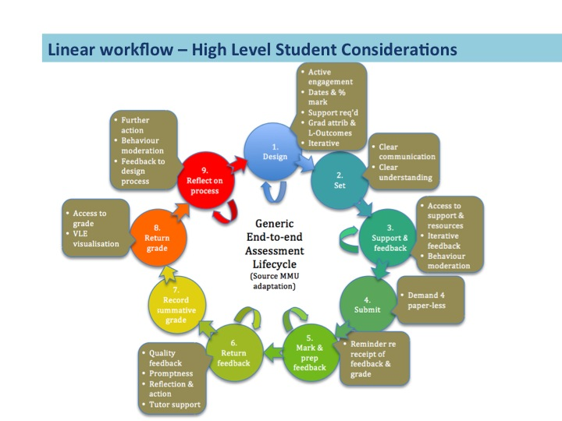
University of Edinburgh
Notes:
Other universities have taken this model and used it to support their conversations – for example this is a diagram from the University of Edinburgh – they’ve created 3 different perspectives to support conversations – for academic staff, students, and support staff. You can see here the versions for academic staff and student perspectives.

Slide 23
Case studies
  Queen’s University, Belfast
  Institute of Education (now part of UCL)
  University of Hertfordshire
  Keele University
  Manchester Metropolitan University
  Bedford College
  Walsall College
EMA
https://www.jisc.ac.uk/guides/transforming-assessment-and-feedback/lifecycle/

Slide 24
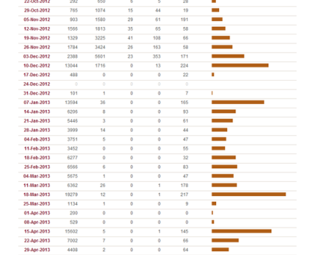
Manchester Metropolitan University
Stage 4: Submitting
Notes:
1. Specifying: as part of the overall undergraduate curriculum change, MMU standardised the credit size of modules (30 credits) and limited the number of summative assignment tasks per module to 2. This was in response to student feedback that there were too many assessment points: up to 20 in a year for some students. The maximum number of summative assignments per student is now 8 per year, including examinations.
An online proforma was designed to capture new unit specifications and store the standardised descriptions in a database. All undergraduate units are now included in this database and the records include information about the type and weighting of the assessment and the skills students are likely to demonstrate in completing the work. This information is linked directly to the student records system (SRS) in order to give a basic picture of the requirements for each unit. For other qualifications, assessment type and weighting information is added manually to the SRS.
This enabled them at Stage 4: Submitting, to use the data to identify critical points for assignment submission (e or otherwise). The persistent emphasis on summative assessment towards the end of the teaching programme has implications for the workload of both students and staff as well as the supporting processes.
To improve this some modelling has been done to identify significant peaks in assignment submissions (the highest being around 17,000 individual submissions due at the end of March 2012). This clearly shows where the main peaks were in the year so is helping inform what the best interventions might be to alleviate workload pressure.

Slide 25
Queen’s University Belfast
Key benefits identified:
  Improvement in student attainment in many areas
  External examiners responded positively to being able to access material in advance of exam boards
  Student satisfaction has increased year on year
  Timely delivery of feedback
  Time savings - one school calculated 20 days of admin staff time saved
Notes:
We have written up a number of case studies collated around the stages in the lifecycle. For example at QUB:
Drivers: to look at the lack of consistency in A&F practice across the institution as evidenced in the NSS. Extend the use of tech, and support student attainment and retention.
Baseline review. Revealed variation in practice e.g. around delivery of feedback and timeliness. Appreciative enquiry approach. Moved to esubmission, marking, feedback initially in School of English but more followed after the success. Driven by pedagogy – developed principles. Analysed timing of assessments. Analysed feedback content.
BENEFITS
The overall approach of using Appreciative Inquiry and supporting teaching staff to plan and implement specific interventions has proven to be an effective means of introducing positive change and is an approach that the University intends to apply to other initiatives.
There have been savings in staff time as a result of introducing e-submission, e-marking and e-feedback e.g. the School of English calculated it had saved 20 days of administrative staff time.
Feedback is being delivered in time to have a positive impact on learning habits. This is particularly noticeable in subjects such as phonetics.
Student attainment has improved in many of the areas where interventions have been undertaken e.g. one Linguistics module has seen a 4% increase in the mean student mark since the introduction of online formative feedback opportunities; Civil Engineering has seen an increase in the mean mark and proportionately fewer fails and third class marks since introducing a range of formative support activities.
External Examiners have responded positively to the convenience of being able to access material well in advance of exam boards.
Student satisfaction with assessment and feedback has increased year on year since 2012 in both internal and external survey

Slide 26
Resources
Now available
  New online guide ‘Transforming assessment and feedback with technology’ now available
  www.jisc.ac.uk/guides/transforming-assessment-and-feedback
  Please share your feedback - http://bit.ly/1STmflx
Coming soon – March 16
  Further clarity on EMA processes and system specification
  An institutional self-assessment tool linking through to the guidance

Slide 27
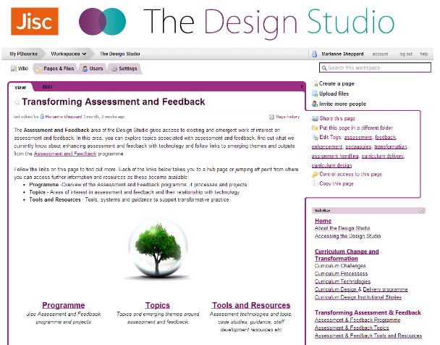





Find out more
  Guide: www.jisc.ac.uk/guides/transforming-assessment-and-feedback
  Baseline review http://repository.jisc.ac.uk/5983/1/JISCAFBaselineReportMay2012.pdf
  Landscape report available from: bit.ly/jisc-ema
  Join the conversation on the blog: ema.jiscinvolve.org/
  and on twitter #jiscassess
  Join the mailing list:
  jiscmail.ac.uk/tech-enhanced-assessment
  Guides, case studies, videos and other resources on assessment and feedback: bit.ly/jisc-assess

Slide 28
Any questions?

Slide 29
Find out more…
Contact
Lisa Gray
Senior Co-Design Manager,
Student Experience
lisa.gray@jisc.ac.uk

